Slide 1

18ECC303J – Computer Communication Networks
_{Course Credit : 4}
_{Theory : 9 Hours}
1. Behrouz A. Forouzan, “Data communication & Networking”, Mc-Graw Hill, 5th Edition Reprint, 2014.
2. Andrew S. Tanenbaum, “Computer Networks”, Pearson Education India, 5th Edition, 2013.
3. William Stallings, “Data & Computer Communication”, Pearson Education India, 10th Edition, 2014.

Slide 2
Unit-4 : TRANSPORT LAYER
Introduction to Transport Layer
TCP/IP Model
User Datagram Protocol(UDP)
Transmission Control Protocol(TCP)
TCP Services & Features
Congestion Control
QOS-Quality of Service
Techniques to improve QOS

Slide 3
Unit 4 –Week 10
Session 1
Introduction to Transport Layer
And TCP/IP Model
Session 2
User Datagram Protocol
(UDP)
Session 3
Transmission Control Protocol
(TCP)

Slide 4
TRANSPORT LAYER - INTRODUCTION

Slide 5
PROCESS-TO-PROCESS DELIVERY
The transport layer is responsible for process-to-process delivery—the delivery of a packet, part of a message, from one process to another. Two processes communicate in a client/server relationship.

Slide 6

TYPES OF DATA DELIVERIES

Slide 7
Client / Server Paradigm
Although there are a several ways to achieve process-to-process communication, the most common is through the client-server paradigm
A process on the local host, called a client, needs services from a process usually on the remote host, called a server.
Both processes (client and server) have the same name. For example, to get the day and time from a remote machine, we need a Daytime client process running on the local host and Daytime server process running on a remote machine.
For communication, local host, local process, remote host, and remote process must be defined.
Addressing
Address is needed to deliver something to one specific destination.
At the data link layer, MAC address is needed to choose one node among several node if the connection is not point –to-point.
At the network layer, IP address is needed to choose one host among millions.
At the transport layer, transport layer address called port number is needed to choose among multiple processes running on the destination host. Destination port number is needed for delivery; source port number is needed for the reply.

Slide 8
Port Numbers
16 bit integers between 0 to 65,535.
The client program defines itself with a port number, chosen randomly by the transport layer software running on the client host.
This is called Ephemeral Port Number.
The server process cannot define itself with a random port number like client program.
Reason: The client requesting to access that server will not know the port number.
Solution: Client to send special packet to server to know its port number. But this requires more overhead.

Slide 9

PORT NUMBERS
Internet has decided to use universal port numbers for servers; these are called well-known port numbers.
Every client process knows the well-known port number of the corresponding server process.
For example, while the daytime client process, a well-known client program, can use an ephemeral (temporary) port number, 52,000, to identify itself, the daytime server process must use the well-known (permanent) port number 13.

Slide 10

IP ADDRESSES VERSUS PORT NUMBERS
IP addresses and port numbers play different roles in selecting the final destination of data.
The destination IP address defines the host among the different hosts in the world.
After the host has been selected, the port number defines one of the processes on this particular host.

Slide 11

IANA ranges
IANA ( Internet Assigned Number Authority ) has divided the port numbers into three ranges: well-known, registered, and dynamic (or private).
Well-known ports. The ports ranging from 0 to 1023 are assigned and controlled by IANA. These are the well-known ports.
Registered ports. The ports ranging from 1024 to 49,151 are not assigned or controlled by IANA. They can only be registered with IANA to prevent duplication.
Dynamic ports. The ports ranging from 49,152 to 65,535 are neither controlled nor registered. They can be used by any process. These are the ephemeral ports.

Slide 12

SOCKET ADDRESS
Process – to – Process delivery needs two identifiers, IP address and the port number, at each end to make a connection.
The combination of an IP address and a port number is called a socket address.
The client socket address defines the client process uniquely just as the server socket address defines the server process uniquely.
Transport layer protocol needs a pair of socket addresses: the client socket address and the server socket address.
These four pieces of information are part of the IP header and the transport-layer protocol header.
The IP header contains the IP addresses; the TCP or UDP header contains the port numbers.

Slide 13

MULTIPLEXING AND DEMULTIPLEXING

Slide 14
MULTIPLEXING & DEMULTIPLEXING
Multiplexing: At the sender site, there may be several processes that need to send packets. However, there is only one transport layer protocol at any time. This is a many to one relationship and require multiplexing. The protocol accepts messages from different processes, differentiated by their assigned port numbers. After adding the header, the transport layer passes the packet to the network layer.
Demultiplexing: At the receiver site, the relationship is one to many and requires demultiplexing. The transport layer receives datagrams from the network layer. After error checking and dropping of the header, the transport layer delivers each message to the appropriate process based on the port number.

Slide 15

ERROR CONTROL

Slide 16

Position of UDP, TCP, and SCTP in TCP/IP suite

Slide 17
USER DATAGRAM PROTOCOL (UDP)

Slide 18
USER DATAGRAM PROTOCOL (UDP)
The User Datagram Protocol (UDP) is called a connectionless, unreliable transport protocol. It does not add anything to the services of IP except to provide process-to-process communication instead of host-to-host communication.

Slide 19
OBJECTIVES
To introduce UDP and show its relationship to other protocols in the TCP/IP protocol suite.
To explain the format of a UDP packet and discuss the use of each field in the header.
To discuss the services provided by the UDP such as process-to-process delivery, multiplexing/demultiplexing, and queuing.
To show how to calculate the optional checksum and the sender needs to add a pseudo header to the packet when calculating the checksum.
To discuss how some application programs can benefit from the simplicity of UDP

Slide 20
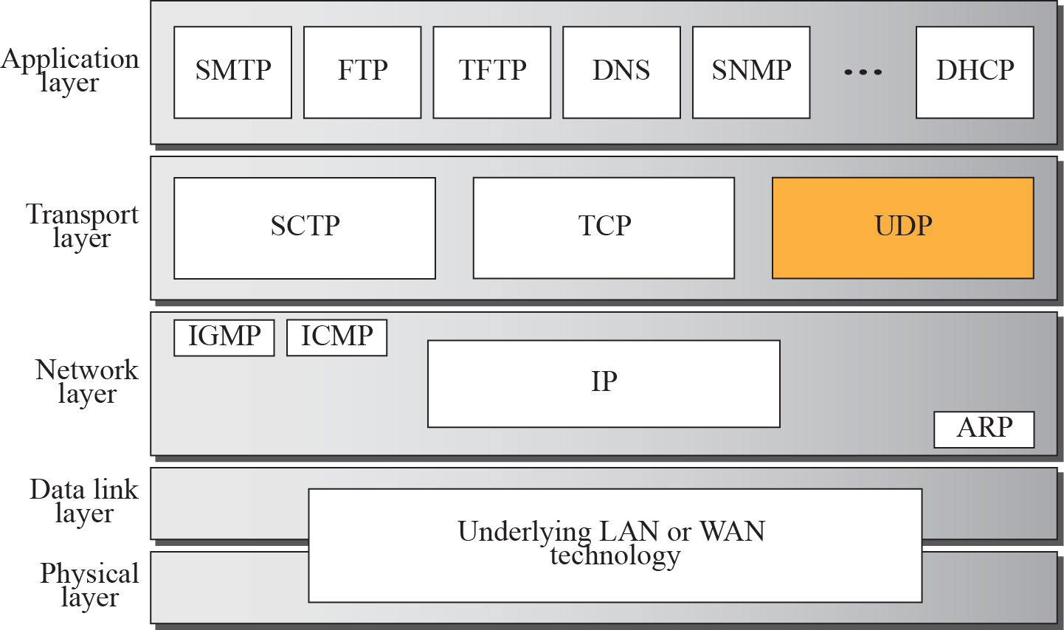
Position of UDP in the TCP/IP protocol suite
Figure shows the relationship of the User Datagram Protocol (UDP) to the other protocols and layers of the TCP/IP protocol suite: UDP is located between the application layer and the IP layer, and serves as the intermediary between the application programs and the network operations.

Slide 21
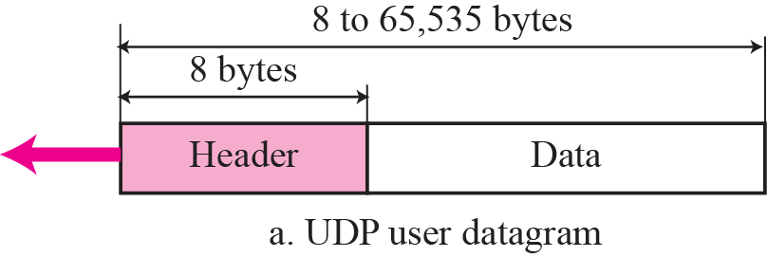
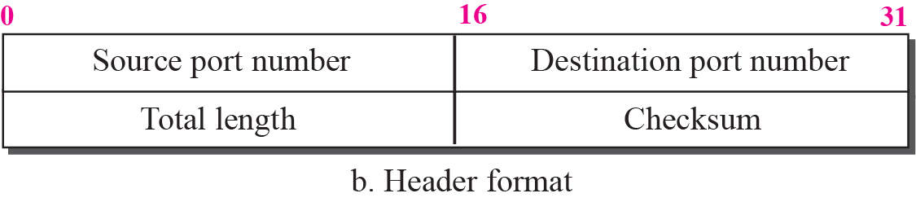
_{USER DATAGRAM FORMAT}
UDP packets, called user datagrams, have a fixed-size header of 8 bytes. Figure shows the format of a user datagram.

Slide 22
USER DATAGRAM FORMAT
UDP has fixed size header of 8 bytes
Source Port Number:
  Port number used by the source host is known as source port number
  It is 16 bits long
  Its range from 0 to 65,535
  If a process on client side is making a request then UDP software (s/w) assigns a temporary port number
  If a process on server side making a request then UDP s/w assigns a well known port number
Destination Port Number:
  The port number used by the process running on the destination host
  It is 16 bits long
  If the process on destination is a client UDP s/w assigns temporary port number
  If the process on destination is a server UDP s/w assigns well know port number.

Slide 23
USER DATAGRAM FORMAT
  Total Length
    It defines the total length (header + data)
    Its range from 0 to 65,535 bytes
    The length field in a UDP is not necessary
    A user datagram is encapsulated in an IP datagram
    There is a field in the IP datagram that defines the total length
    UDP Length = IP length – IP header’s length

Slide 24

PSEUDO HEADER FOR CHECKSUM CALCULATION

Slide 25
CHECKSUM
This field is used to detect errors over the entire user datagram (Header Plus data)
UDP checksum calculations is different from IP
The checksum include 3 sections
  A Pseudo header
  UDP Header
  Data coming from the application layer
Pseudo header is the part of the header of the IP packet in which the user datagram is to be encapsulated.

Slide 26
_{UDP Services}
Service provided by UDP are as follows :
_{Connectionless Service}
_{Flow and Error Control}
Encapsulation and Decapsulation
Multiplexing and Demultiplexing

Slide 27
CONNECTIONLESS SERVICE
UDP provides connectionless service
Each user datagram sent by UDP is an independent datagram
There is no relationship between different user datagram
They are not numbered
No connection establishment and no connection release
Each user datagram can travel on a different path.

Slide 28
FLOW AND ERROR CONTROL
UDP is very simple, unreliable transport protocol
No flow control, so no window mechanism
No error control mechanism except for the checksum (Just to drop!)
The sender does not know if a message has been lost (or) duplicated
Lack of flow (drop) and error control (optional) means that the process using UDP should provide these mechanisms.

Slide 29
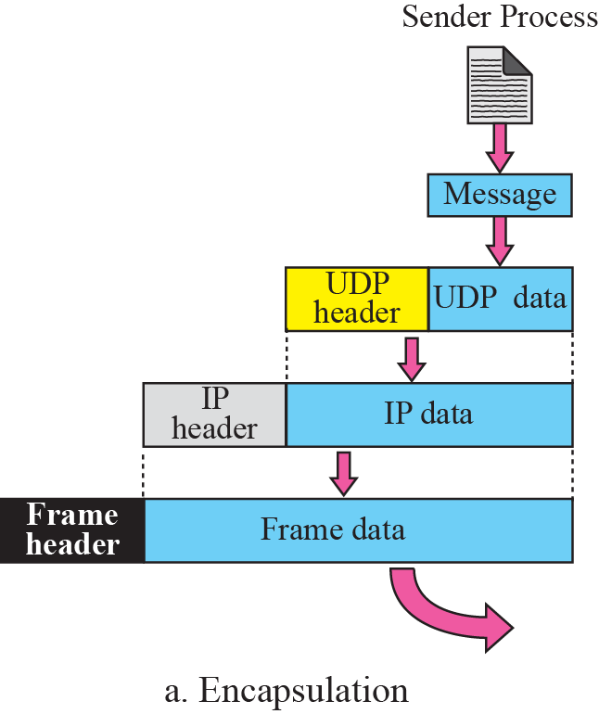
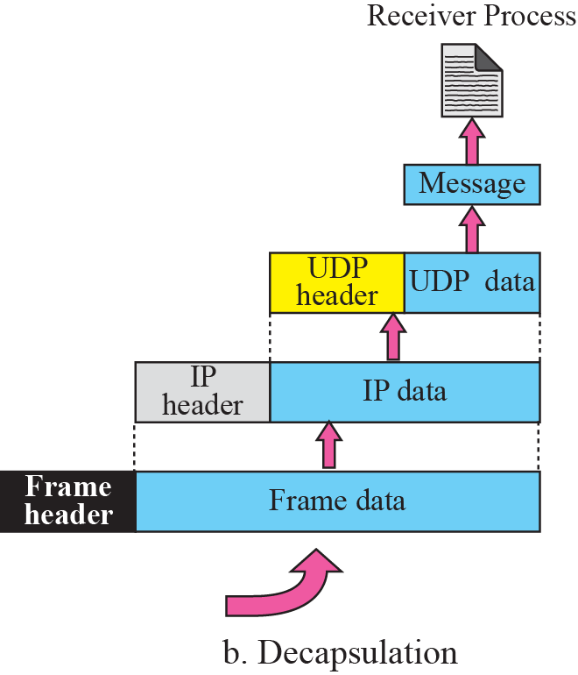

ENCAPSULATION AND DECAPSULATION

Slide 30
ENCAPSULATION AND DECAPSULATION
To send a message from one process to another the UDP protocol encapsulates and decapsulates message
Encapsulate
  Process passes its message to UDP along with pair of socket address and length of data
  Then UDP receives the data and adds UDP header
  Then it passes the user datagram to IP with the socket address
  IP adds its own header
  In its protocol field the value of UDP is 17
  The IP datagram is then passed to the data link layer
  It adds is own header and passes it to the physical layer
  The physical layer encodes the bits into electrical (or) optical signals and sends it to the remote machine.

Slide 31
ENCAPSULATION AND DECAPSULATION
Decapsulate:
  When the message arrives at the destination host
  The physical layer decodes the signals into bits and passes it to the data link layer.
  The data link layer uses the header to check the data
  If there is no error, the header and trailer are dropped and the datagram is passed to IP
  IP software does its checking
  If no error, the header is dropped and the user datagram is passed to UDP with sender and receiver IP address
  UDP uses the checksum to check the entire user datagram
  If there is no error, the header is dropped
  Then the data along with the sender socket address is passed to the process.

Slide 32
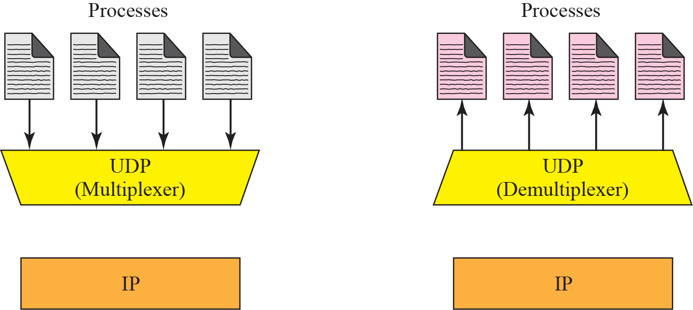





MULTIPLEXING AND DEMULTIPLEXING

Slide 33
MULTIPLEXING AND DEMULTIPLEXING
There is only one UDP, but several processes that may want to use the service of UDP
For this UDP uses MUX AND DEMUX
MULTIPLEXING:
  At the sender there may be several processes that need to send user datagram
  There is only one UDP
  Many to one relationship requires Multiplexing
  UDP accepts message from different processes
  Differentiated by their assigned port numbers
  After adding the header
  UDP passes the user datagram to the IP

Slide 34
MULTIPLEXING AND DEMULTIPLEXING
DEMULTIPLEXING:
  At the receiving side only one UDP
  Many processes that can receiver user datagrams
  This is one to many – requires demultiplexing
  UDP receiver user datagram from IP
  After error checking and dropping of the header
  UDP delivers each message to the appropriate processes based on the port numbers.

Slide 35

Queues in UDP
At the client site, when a process starts, it requests a port number from the operating system. If a process wants to communicate with multiple processes, it obtains only one port number and eventually one outgoing and one incoming queue. The queues opened by the client are identified by ephemeral port number. The queues function as long as the process is running. When the process terminates, the queues are destroyed.

Slide 36
UDP FEATURES
It is suitable for a process that requires simple (light weight) request –response communication with little flow or error control
It is suitable for a process with internal flow-error control mechanism (Example: Trivial File Transfer Protocol)
It is a suitable transport protocol for multicasting
It is used for Management processes example : Simple Network Management Protocol (SNMP)
It is used for some route updating protocol such Routing Information protocol (RIP)

Slide 37


WELL-KNOWN PORTS USED WITH UDP

Slide 38
REVIEW QUESTIONS
1. The following is the content of a UDP header in hexadecimal format : CB84000D001C001C
a. What is the source port number?
b. What is the destination port number?
c. What is the total length of the user datagram?
d. What is the length of the data?
e. Is the packet directed from a client to a server or vice versa?
f. What is the client process?

Slide 39
REVIEW QUESTIONS
2. The UDP Length can be calculated by _____
3. Which port number is used for echo server?
4. One of the responsibilities of the transport layer protocol is to create a _____ communication.
5.UDP is called a ______ transport protocol
6. Although there are several ways to achieve process-to-process communication, the most common is through the___ paradigm
7. The combination of an IP address and a port number is called as _____
8. The ports ranging from 49,152 to 65,535 can be used as temporary or private port numbers. They are called ___ the ports

Slide 40
Solution
1.a. The source port number is the first four hexadecimal digits
(CB84)16, which means that the source port number is 52100.
b. The destination port number is the second four hexadecimal
digits (000D)16, which means that the destination port
number is 13.
c. The third four hexadecimal digits (001C)16 define the length
of the whole UDP packet as 28 bytes.
d. The length of the data is the length of the whole packet minus
the length of the header, or 28 − 8 = 20 bytes.
e. Since the destination port number is 13 (well-known port),
the packet is from the client to the server.
f. The client process is the Daytime (Refer the slide no 37)

Slide 41
Solution
2. IP length – IP header’s length
3. 7
4. Process-to-process
5. Connectionless, unreliable
6. Client-server
7. Socket address
8. dynamic

Slide 42
Transmission Control Protocol(TCP)

Slide 43
TCP
TCP is a connection-oriented, reliable protocol.
TCP explicitly defines connection establishment, data transfer, and connection tear down phases to provide a connection-oriented service.
TCP uses a combination of GBN and SR protocols to provide reliability.
To achieve this goal, TCP uses checksum (for error detection), retransmission of lost or corrupted packets, cumulative and selective acknowledgments, and timers

Slide 44
Position of UDP, TCP, and SCTP in TCP/IP suite

Slide 45
TCP SERVICES
Process to Process Communication
Stream Delivery Service
  Sending and receiving buffers
  Segments
Full – duplex communication
Multiplexing and Demultiplexing
Connection-Oriented Service
Reliable service

Slide 46
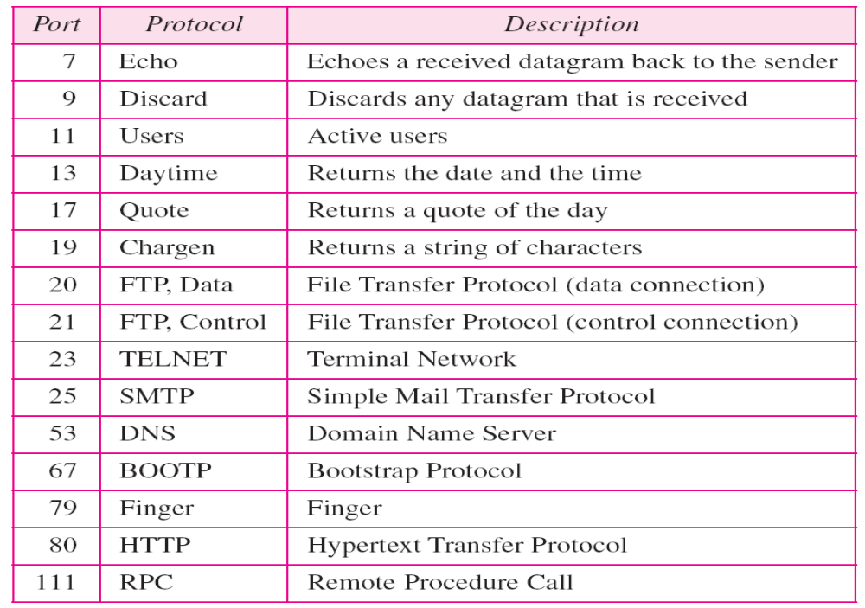
1. Process-to process communication
TCP provides process – process communication using port number
The following are well known port numbers used by TCP

Slide 47

2. Stream Delivery
TCP allows the sending process to deliver data as a stream of bytes and allows the receiving process to obtain data as a stream of bytes.
It creates an environment that two processes seem to be connected.
The sending process produces the steam of bytes and receiving process consumes them.

Slide 48

2.a Sending and Receiving Buffers

Slide 49
2.a Sending and Receiving Buffers
One way to implement a buffer is to use a circular array of 1 byte location.
The above figure shows two buffers of 20 bytes each
Generally the buffers are hundreds or thousands of bytes
It shows the movement of the data in one direction
SENDING SIDE:
  The buffer has three types of chambers
  White section contains empty chambers that can be filled by the sending process
  The gray area holds bytes that have been sent but not yet acknowledged
  TCP keeps these bytes in the buffer until it receives an acknowledgement
  The colored area contains bytes to be sent by the sending TCP
  After the bytes in the gray chambers are acknowledged the chambers are recycled and available for use by the sending process

Slide 50
2.a Sending and Receiving Buffers
Receiver side:
  The operation of the buffer at the receiver site is simpler
  The circular buffer is divided into two areas (white and colored)
  The white area contain empty chambers to be filled by bytes received by the network
  The colored sections contains received bytes that can be read by the receiving process
  When the bytes is read by the receiving process, the chamber is recycled and added to the pool of empty chambers

Slide 51

2.b TCP segments

Slide 52
2.b TCP segments
Although buffering handles the disparity between the speed of the producing and consuming processes, we need one more step before we can send the data.
IP layer, as a service provider for TCP needs to send data in packets, not a stream of bytes
At the transport layer, TCP groups a number of bytes together into a packet called a segment.
TCP adds a header to each segment (for control purposes) and delivers the segment to the IP layer for transmission
The segments are encapsulated in an IP datagram and transmitted
The entire operation is transparent to the receiving process
In the above figure, one segment carrying 3 bytes and the other carrying 5 bytes of data
Note that segments are not necessarily the same size.

Slide 53
3. Full-Duplex Communication
TCP offers Full duplex service
Data can flow in both directions at the same time
Each TCP then has a sending and receiving buffer and segments move in both directions
4. Multiplexing and Demultiplexing
Like UDP, TCP performs multiplexing at the sender and demultiplexing at the receiver

Slide 54
5. Connection-Oriented Service
  TCP is a connection-oriented protocol
  In this services the following three steps will occur:
  1. The two TCP’s establish a logical connection between them
  2. Data are exchanged in both directions
  3. The connection is terminated
  This is virtual connection
  TCP segment is encapsulated in an IP datagram
  It can be sent out of order, or lost, or corrupted and then resent
  Each may use different path to reach the destination
6. Reliable Service
  TCP is a reliable transport protocol
  It uses an acknowledgement mechanism to check the safe and sound arrival of data

Slide 55
TCP FEATURES
Numbering System
  Byte Number
  Sequence Number
  Acknowledgement Number
Flow Control
Error Control
Congestion Control

Slide 56
Byte Number
  TCP numbers all data bytes that are transmitted in a connection
  When TCP receives bytes of data from a process it stores them in the sending buffer and numbers them
  The numbering does not start from 0
  TCP generates a random number between 0 and 2³² -1 for the first byte
  For Example the random number is 1,057 and total data to be sent is 6,000 bytes
  The bytes are numbered from 1057 to 7056
Note:
The bytes of data being transferred in each connection are numbered by TCP.
The numbering starts with a randomly generated number.

Slide 57

Sequence Number
After the bytes have been numbered, TCP assigns a sequence number to each segment that is being sent.
The sequence number for each segment is the number of the first byte carried in that segment.
The following shows the sequence number for each segment:
Note:
The value in the sequence number field of a segment defines the number of the first data byte contained in that segment.

Slide 58
Acknowledgment Number
  Each party uses an acknowledgement number to confirm the bytes it has received
  Ack number defines that the number of the next byte that the party expects to receive
  The ack number is cumulative which means that party takes the number of the last byte that it has received safe and sound, adds 1 to it, and announces this sum as the acknowledgement number
  For example: if a party uses 5,643 as an ack number, i.e. it has received all bytes from the beginning up to 5,642.
  This does not mean that the party has received 5,642 bytes because the first byte number does not have to start from 0
Note:
The value of the acknowledgment field in a segment defines the number of the next byte a party expects to receive. The acknowledgment number is cumulative.

Slide 59
Flow control
  TCP provides flow control
  The numbering system allows TCP to use a byte oriented flow control
Error control
  To provide reliable service
  TCP implements an error control mechanism
Congestion Control
  TCP takes into account congestion in the network
  It determined by the level of congestion in the network

Slide 60

TCP segment format

Slide 61
TCP SEGMENT FORMAT
Introduction
  The packet in TCP is called a segment
  The segment consists of 20 – 60 bytes header, followed by data from the application program
  The header is 20 bytes – there are no options
  Header is up to 60 bytes – if it contains options
Source Port Address
  It is a 16 bits field defines the port number of the host that is sending the segment
Destination Port Address
  It is a 16 bits field defines the port number of the host that is receiving the segment

Slide 62
TCP SEGMENT FORMAT
Sequence Number
  It is 32 bit field defines the number assigned to the first byte of data contained in this segment.
  Each byte to be transmitted is numbered
  Sequence number tells the destination which byte in this sequence comprises the first byte in the segment
  During connection establishment, each party uses a random number generator to create an initial sequence number (ISN) which is usually different in each direction
Acknowledgement number
  This is 32 bit field
  It defines the byte number that the receiver of the segment is expecting to receive from the other party.
  If the receiver of the segment has successfully received byte number x from the other party, it defines x + 1 as the acknowledgement number
  Ack. and data can be piggy backed together.

Slide 63
TCP SEGMENT FORMAT
Header Length
  This 4 bit field indicates the number of 4 byte word in the TCP header
  The length of the header can be between 20 – 60 bytes
  The value of the field can be between 5 (5 x4 = 20) and 15 (15x4=60)
Reserved
  This is a 6 bit field reserved for future use
Window Size
  This field defines the size of the window in bytes, that the other party must maintain
  The length of this field is 16 bits
  Maximum size of the window is 65,535 bytes
  This value is normally referred to as the receiving window (rwnd) and it is determined by the receiver
  The sender must obey the dictation of the receiver in this case.

Slide 64

Control Field

Slide 65
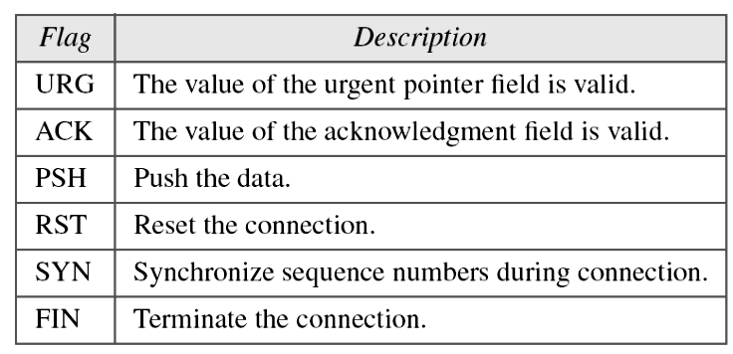
Control Field
This field defines 6 different control bits or flags as shown above.
One or more of these bits can be set at a time
These bits enable flow control, connection establishing and termination, connection absorption and the mode of data transfer in TCP
The following table shows the description of flags in the control field

Slide 66
Checksum
  This 16 bit field contains the checksum
  Calculation of the checksum for TCP is same as UDP
  Inclusion of checksum in UDP is optional
  But checksum in TCP is mandatory
Urgent pointer
  This 16 bit field
  It is valid only if the urgent flag is set
  It is used when the segment contains urgent data
Options
  There can be up to 40 bytes of optional information in the TCP header
Encapsulation
  A TCP segment is encapsulated in an IP data gram which in turn is encapsulated in the frame at the data line layer
Frame Header | IP header | TCP segment

Slide 67
Unit 4 –Week 11
Session 4
TCP Connections
Flow Control
Session 5
TCP Error Control
Session 6
Congestion Control
_{<number>}

Slide 68
TCP Connection
TCP operates at a higher level.
TCP uses the services of IP to deliver individual segments to the receiver, but it controls the connection itself.
If a segment is lost or corrupted, it is retransmitted. Unlike TCP, IP is unaware of this retransmission.
If a segment arrives out of order, TCP holds it until the missing segments arrive; IP is unaware of this reordering.
In TCP, connection-oriented transmission requires three phases: connection establishment, data transfer, and connection termination

Slide 69
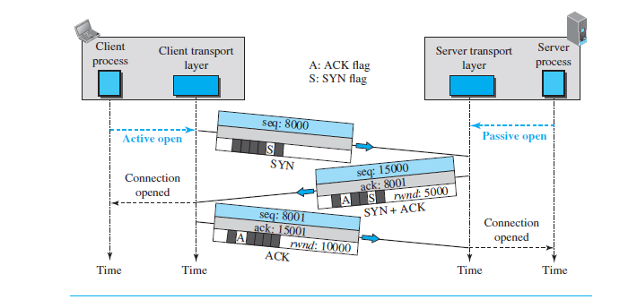
Connection establishment using three-way handshaking
An application program, called the client, wants to make a connection with another application program, called the server, using TCP as the transport-layer protocol.
The process starts with the server. The server program tells its TCP that it is ready to accept a connection. This request is called a passive open.
Although the server TCP is ready to accept a connection from any machine in the world, it cannot make the connection itself. The client program issues a request for an active open.
A client that wishes to connect to an open server tells its TCP to connect to a particular server. TCP can now start the three-way handshaking process.

Slide 70
Connection establishment using three-way handshaking
Three steps in this phase are as follows: (Refer previous slide diagram)
1.The client sends the first segment, a SYN segment, in which only the SYN flag is set. This segment is for synchronization of sequence numbers. The client in our example chooses a random number as the first sequence number and sends this number to the server. This sequence number is called the initial sequence number (ISN)
2. The server sends the second segment, a SYN + ACK segment with two flag bits set as: SYN and ACK. This segment has a dual purpose. First, it is a SYN segment for communication in the other direction. The server uses this segment to initialize a sequence number for numbering the bytes sent from the server to the client. The server also acknowledges the receipt of the SYN segment from the client by setting the ACK flag and displaying the next sequence number it expects to receive from the client. Because the segment contains an acknowledgment, it also needs to define the receive window size, rwnd (to be used by the client).
3.The client sends the third segment. This is just an ACK segment. It acknowledges the receipt of the second segment with the ACK flag and acknowledgment number field.

Slide 71
Connection establishment using three-way handshaking
Note:
A SYN segment cannot carry data, but it consumes one sequence number.
A SYN + ACK segment cannot carry data, but does consume one sequence number.
An ACK segment, if carrying no data, consumes no sequence number.

Slide 72

Data Transfer
After connection is established, bidirectional data transfer can take place. The client and server can send data and acknowledgments in both directions.
After a connection is established, the client sends 2,000 bytes of data in two segments. The server then sends 2,000 bytes in one segment. The client sends one more segment.
The first three segments carry both data and acknowledgment, but the last segment carries only an acknowledgment because there is no more data to be sent.
The data segments sent by the client have the PSH (push) flag set so that the server TCP knows to deliver data to the server process as soon as they are received.
The segment from the server, on the other hand, does not set the push flag. Most TCP implementations have the option to set or not to set this flag.

Slide 73

Connection termination using three-way handshaking

Slide 74
Connection termination using three-way handshaking
1. In normal situation, the client TCP, after receiving a close command from the client
process, sends the first segment, a FIN segment in which the FIN flag is set. Note
that a FIN segment can include the last chunk of data sent by the client or it can be
just a control segment as shown in the figure. If it is only a control segment, it consumes
only one sequence number because it needs to be acknowledged.
2. The server TCP, after receiving the FIN segment, informs its process of the situation
and sends the second segment, a FIN + ACK segment, to confirm the receipt of the
FIN segment from the client and at the same time to announce the closing of the connection in the other direction. This segment can also contain the last chunk of data
from the server. If it does not carry data, it consumes only one sequence number
because it needs to be acknowledged.
3. The client TCP sends the last segment, an ACK segment, to confirm the receipt of
the FIN segment from the TCP server. This segment contains the acknowledgment
number, which is one plus the sequence number received in the FIN segment from
the server. This segment cannot carry data and consumes no sequence numbers.

Slide 75
Connection termination using three-way handshaking
Note:
The FIN segment consumes one sequence number if it does not carry data.
The FIN + ACK segment consumes one sequence number if it
does not carry data.

Slide 76

Half-close
In TCP, one end can stop sending data while still receiving data. This is called a half-close.
Either the server or the client can issue a half-close request. It can occur when the server needs all the data before processing can begin.
A good example is sorting. When the client sends data to the server to be sorted, the server needs to receive all the data before sorting can start.
This means the client, after sending all data, can close the connection in the client-to-server direction. However, the server-to-client direction must remain open to return the sorted data.
The server, after receiving the data, still needs time for sorting; its outbound direction must remain open.

Slide 77
Note:
ACK segments do not consume sequence numbers and are not acknowledged.
In modern implementations, a retransmission occurs if the retransmission timer expires or three duplicate ACK segments have arrived.
No retransmission timer is set for an ACK segment.
Data may arrive out of order and be temporarily stored by the receiving TCP, but TCP guarantees that no out-of-order segment is delivered to the process.

Slide 78
Flow Control
TCP uses a sliding window to handle flow control.
Sliding window in TCP looks like GBN – It doesn’t use NAKs.
Looks like SR – Receiver holds out of order segments until the missing ones arrive.
Sliding window at DL layer and TCP
DL TCP
Frame oriented Byte oriented
Fixed size window Variable size
The size of the window at one end is determined by the lesser of two values: receiver window (rwnd) and congestion window (cwnd).
rwnd – No. of bytes the receiver can accept before its buffer overflows and data are discarded.
cwnd – value determined by the network to avoid congestion.

Slide 79

The window spans a portion of the buffer containing bytes received from the process.
The bytes inside the window can be sent without worrying about ack.
The imaginary window has two walls: One left and one right.
Window – Opened, Closed or Shrunk.
Depend on the congestion in the network and in the control of the receiver, not the sender.
Opening a window – moving the right wall to the right. Allows more new bytes eligible for sending.
Closing the window – Moving the left wall to the right. Some bytes are acknowledged.
Shrinking the window – Moving the right wall to the left.
Moving the left wall to the left – not allowed.

Slide 80
Example: What is the value of the receiver window (rwnd) for host A if the receiver, host B, has a buffer size of 5000 bytes and 1000 bytes of received and unprocessed data?
Solution
The value of rwnd = 5000 − 1000 = 4000. Host B can receive only 4000 bytes of data before overflowing its buffer. Host B advertises this value in its next segment to A.

Slide 81
Example: What is the size of the window for host A if the value of rwnd is 3000 bytes and the value of cwnd is 3500 bytes?
Solution
The size of the window is the smaller of rwnd and cwnd, which is 3000 bytes.

Slide 82
Error Control
TCP is a reliable transport protocol.
Data sent in order, without error, without any part lost or duplicated.
TCP provides reliability using error control.
Error control in TCP involves
Detecting corrupted segments, lost segments, out – of-order segments, and duplicated segments.
Correcting errors after they are detected.
Error detection and correction in TCP is done using three tools:
Checksum
Acknowledgement
Time-out

Slide 83
1. Checksum
Each segment includes a checksum field which is used to check for a corrupted segment.
If the segment is corrupted, it is discarded by the destination TCP and is considered as lost.
TCP uses 16 bit checksum that is mandatory in every segment.
2. Acknowledgement
TCP uses acknowledgements to confirm the receipt of data segments.
Control segments that carry no data but consume a sequence number are also acknowledged.
ACK segments are never acknowledged.

Slide 84
3. Time-out
Retransmission
The heart of the error control mechanism is the retransmission of segments.
When a segment is corrupted, lost or delayed, it is retransmitted.
Segment is retransmitted when
retransmission timer expires
the sender receives three duplicate ACKs.
No retransmission for segments that do not consume sequence number.
No retransmission for ACK segment.

Slide 85
(i) Retransmission after Retransmission Time-Out (RTO)
TCP maintains RTO timer for all outstanding (sent, but not acknowledged) segments.
When the timer matures, the earliest outstanding segment is retransmitted.
No time-out timer is set for ACK segment .
Value of RTO is dynamic in TCP and is updated based on Round Trip Time (RTT) of segments.
RTT – Time needed for the segment to reach a destination and ACK to be received.

Slide 86
(ii) Retransmission after 3 duplicate ACKs
If one segment is lost, the receiver receives so many out of order segments that they cannot be saved (receiver buffer size is limited)
Three Duplicate ACKs rule:
Retransmit missing segment immediately. This is called fast retransmission ( Example scenario given in next section)
Out of Order Segments
TCP do not discard out of order segments.
They store them temporarily and flag them as out of order segments until the missing segment arrives.
Out of order segments are not delivered to the process.
TCP guarantees that the data are delivered to the process in order.

Slide 87

Some Scenarios of TCP

Slide 88

Normal Operation
When the client receives the first segment from the server, it does not have any more data to send; it needs to send only an ACK segment.
However, the acknowledgment needs to be delayed for 500 ms to see if any more segments arrive.
When the timer matures, it triggers an acknowledgment. This is so because the client has no knowledge of whether other segments are coming; it cannot delay the acknowledgment forever.
When the next segment arrives, another ACK timer is set. However, before it matures, the third segment arrives. The arrival of the third segment triggers another acknowledgment.

Slide 89

Lost segment
Assume that data transfer is unidirectional: one site is sending, the other is receiving.
In this scenario, the sender sends segments 1 and 2, which are acknowledged immediately by an ACK.
Segment 3, however, is lost.
The receiver receives segment 4, which is out of order.
The receiver stores the data in the segment in its buffer but leaves a gap to indicate that there is no continuity in the data.
The receiver immediately sends an acknowledgment to the sender displaying the next byte it expects.
Note that the receiver stores bytes 801 to 900, but never delivers these bytes to the application until the gap is filled.
Note: The receiver TCP delivers only ordered data to the process.

Slide 90

Fast retransmission
The scenario shows the idea of fast transmission.
Each time the receiver receives the fourth, fifth and sixth segments, it triggers an acknowledgment.
The sender receives four acknowledgments with the same value (three duplicates).
Although the timer for segment 3 has not matured yet, the fast retransmission requires that segment 3, the segment that is expected by all of these duplicate acknowledgments, be resent immediately.
Note that only one segment is retransmitted
although two segments are not acknowledged.
When the sender receives the retransmitted ACK, it knows that both segments are safe and sound because the acknowledgment is cumulative.

Slide 91
Review Questions
TCP is a ________ protocol.
TCP groups a number of bytes together into a packet called a ______
Communication offered by TCP is ________
In segment header, sequence number and acknowledgement number fields refer to _______
The value of acknowledgement field in a segment defines _______
Connection establishment in TCP is done by which mechanism ?
The server program tells its TCP that it is ready to accept a connection. This process is called ___________
Size of TCP segment header ranges between ___________
A client that wishes to connect to an open server tells its TCP that it needs to be connected to that particular server. The process is called ___________
A __________segment cannot carry data, but does consume one sequence number.

Slide 92
Solutions
Connection-oriented
Segment
Full duplex
Byte number
sequence number of the next byte to be received
Three-Way Handshaking
7. Passive open
20 and 60 bytes
Active open
SYN + ACK

Slide 93
CONGESTION

Slide 94
DATA TRAFFIC
The main focus of congestion control and quality of service is data traffic. In congestion control we try to avoid traffic congestion. In quality of service, we try to create an appropriate environment for the traffic. So, before talking about congestion control and quality of service, data traffic is discussed.

Slide 95

_{Traffic descriptors}
Traffic descriptors are qualitative values that represent a data flow.
The average data rate is the number of bits sent during a period of time, divided by the number of seconds in that period. It indicates the average bandwidth needed by the traffic.
The peak data rate defines the maximum data rate of the traffic. In figure, it is the maximum y axis value. It indicates the peak bandwidth that the network needs for traffic to pass through without changing its data flow.

Slide 96

_{Three traffic profiles}
Constant bit rate (CBR) : The traffic model has a data rate that does not change.
Average data rate and peak data rate are the same.
Variable bit rate (VBR) : The rate of data flow changes in time, with the changes smooth instead of sudden and sharp.
Bursty : The data rate changes suddenly in a very short time. Bursty traffic is one of the main causes of congestion in a network

Slide 97
CONGESTION
Congestion in a network may occur if the load on the network—the number of packets sent to the network—is greater than the capacity of the network—the number of packets a network can handle. Congestion control refers to the mechanisms and techniques to control the congestion and keep the load below the capacity.

Slide 98

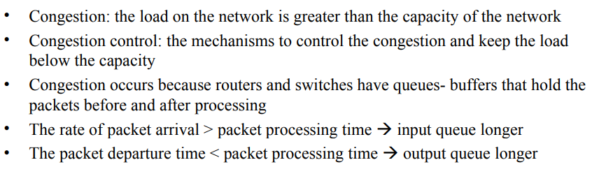
_{Queues in a Router}

Slide 99

Packet delay and throughput as functions of load
Packet delay versus Network load.
Delay is composed of propagation delay and processing delay.
Throughput versus network load
Throughput: the number of packets passing through the network in a unit of time.

Slide 100
CONGESTION CONTROL
Congestion control refers to techniques and mechanisms that can either prevent congestion, before it happens, or remove congestion, after it has happened. In general, we can divide congestion control mechanisms into two broad categories: open-loop congestion control (prevention) and closed-loop congestion control (removal).

Slide 101

_{Congestion Control Categories}

Slide 102
Open-Loop Congestion Control
In open-loop congestion control, policies are applied to prevent congestion before it happens.
In these mechanisms, congestion control is handled by either the source or the destination.
We give a brief list of policies that can prevent congestion.
Retransmission policy
Window policy
Acknowledgment policy
Discarding policy
Admission policy

Slide 103
Retransmission Policy
Retransmission is sometimes unavoidable.
If the sender feels that a sent packet is lost or corrupted, the packet needs to be retransmitted.
Retransmission in general may increase congestion in the network.
However, a good retransmission policy can prevent congestion.
The retransmission policy and the retransmission timers must be designed to optimize efficiency and at the same time prevent congestion.
For example, the retransmission policy used by TCP is designed to prevent or alleviate congestion.

Slide 104
Window Policy
The type of window at the sender may also affect congestion.
The Selective Repeat window is better than the Go-Back-N window for congestion control.
In the Go-Back-N window, when the timer for a packet times out, several packets may be resent, although some may have arrived safe and sound at the receiver.
This duplication may make the congestion worse.
The Selective Repeat window, on the other hand, tries to send the specific packets that have been lost or corrupted.

Slide 105
Acknowledgment Policy
The acknowledgment policy imposed by the receiver may also affect congestion. (delaying)
If the receiver does not acknowledge every packet it receives, it may slow down the sender and help prevent congestion.
Several approaches are used in this case.
A receiver may send an acknowledgment only if it has a packet to be sent (piggyback) or a special timer expires.
A receiver may decide to acknowledge only N packets at a time. (cumulative)
We need to know that the acknowledgments are also part of the load in a network.
Sending fewer acknowledgments means imposing less load on the network.

Slide 106
Discarding Policy
A good discarding policy by the routers may prevent congestion and at the same time may not harm the integrity of the transmission.
For example, in audio transmission, if the policy is to discard less sensitive packets when congestion is likely to happen, the quality of sound is still preserved and congestion is prevented or alleviated.

Slide 107
Admission Policy
An admission policy, which is a quality-of-service mechanism, can also prevent congestion in virtual-circuit networks.
Switches in a flow first check the resource requirement of a flow before admitting it to the network.
A router can deny establishing a virtual circuit connection if there is congestion in the network or if there is a possibility of future congestion.

Slide 108
Closed-Loop Congestion Control
Closed-loop congestion control mechanisms try to alleviate congestion after it happens.
Several mechanisms have been used by different protocols. We describe a few of them here.
Back pressure
Choke packet
Implicit signaling
Explicit signaling

Slide 109
Backpressure
The technique of backpressure refers to a congestion control mechanism in which a congested node stops receiving data from the immediate upstream node or nodes.
This may cause the upstream node or nodes to become congested, and they, in turn, reject data from their upstream nodes or nodes. And so on.
Backpressure is a node-to-node congestion control that starts with a node and propagates, in the opposite direction of data flow, to the source.
The backpressure technique can be applied only to virtual circuit networks, in which each node knows the upstream node from which a flow of data is coming

Slide 110

Backpressure Method for Alleviating Congestion

Slide 111

_{Choke packet}
A choke packet is a packet sent by a node to the source to inform it of congestion.
In backpressure, the warning is from one node to its upstream node, although the warning may eventually reach the source station.
In the choke packet method, the warning is from the router, which has encountered congestion, to the source station directly.
The intermediate nodes through which the packet has traveled are not warned.

Slide 112
Implicit Signaling
In implicit signaling, there is no communication between the congested node or nodes and the source.
The source guesses that there is a congestion somewhere in the network from other symptoms.
For example, when a source sends several packets and there is no acknowledgment for a while, one assumption is that the network is congested.
The delay in receiving an acknowledgment is interpreted as congestion in the network; the source should slow down.

Slide 113
Explicit Signaling
The node that experiences congestion can explicitly send a signal to the source or destination.
The explicit signaling method, however, is different from the choke packet method.
In the choke packet method, a separate packet is used for this purpose.
In the explicit signaling method, the signal is included in the packets that carry data.
Explicit signaling, can occur in either the forward or the backward direction. (ECN – Explicit Congestion Notification)

Slide 114
Backward Signaling
A bit can be set in a packet moving in the direction opposite to the congestion.
This bit can warn the source that there is congestion and that it needs to slow down to avoid the discarding of packets.
Forward Signaling
A bit can be set in a packet moving in the direction of the congestion.
This bit can warn the destination that there is congestion.
The receiver in this case can use policies, such as slowing down the acknowledgments, to alleviate the congestion.

Slide 115

Congestion Control in TCP
1.Slow start, exponential increase
TCP’s general policy for handling congestion is based on three algorithms: slow start, congestion avoidance, and congestion detection.
1.Slow start, exponential increase :
The size of the congestion window
(cwnd) starts with one maximum segment size (MSS), but it increases one MSS each time an acknowledgment is received.
Note:
In the slow-start algorithm, the size of the congestion window increases exponentially until it reaches a threshold.

Slide 116
Contd..
The sender starts with cwnd = 1. This means that the sender can send only one segment.
After receipt of the acknowledgment for segment 1, the size of the congestion window is increased by 1, which means that cwnd =2.
Now two more segments can be sent. When each acknowledgment is received, the size of the window is increased by 1 MSS. When all seven segments are acknowledged, cwnd=8
If we look at the size of cwnd in terms of rounds (acknowledgment of the whole window of segments), the rate is exponential as shown below:
Start, cwnd = 1
After round 1, cwnd = 2¹ = 2
After round 2, cwnd = 2² = 4
After round 3, cwnd = 2³ = 8

Slide 117

2. Congestion avoidance, additive increase
If we start with the slow-start algorithm, the size of the congestion window increases exponentially.
To avoid congestion before it happens, we must slow down this exponential growth. TCP defines another algorithm called congestion avoidance, which increases the cwnd additively instead of exponentially.
When the size of the congestion window reaches the slow-start threshold, the slow-start phase stops and the additive phase begins.
In this algorithm, each time the whole “window” of segments is acknowledged, the size of the congestion window is increased by one.
If we look at the size of cwnd in terms of rounds (acknowledgment of the whole window of segments), the rate is additive as shown below:
Note:
In the congestion avoidance algorithm, the size of the congestion window increases additively until congestion is detected.
Start, cwnd = 1
After round 1, cwnd = 1+1=2
After round 2, cwnd = 2+1=3
After round 3, cwnd = 3+1=4

Slide 118
3. Congestion detection, multiplicative decrease
If congestion occurs, the congestion window size must be decreased.
However, retransmission can occur in one of two cases: When a timer times out or when three ACKs are received. In both cases, the size of the threshold is dropped to one-half, a multiplicative decrease.
Most TCP implementations have two reactions:
If a time out occurs, there is a stronger possibility of congestion; a segment has probably
been dropped in the network and there is no news about the sent segments. In this
case TCP reacts strongly:
a. It sets the value of the threshold to one half of the current window size.
b. It sets cwnd to the size of one segment
c. It sets the slow-start phase again.
2. If three ACKs are received , there is a weaker possibility of congestion; a segment may
have dropped, but some segments after that may have arrived safely since three ACKs
are received. This is called fast transmission and fast recovery. In this case, TCP has a
weaker reaction:
a. It sets the value of the threshold to one half of the current window size.
b. It sets cwnd to the value of the threshold.
c. It sets the congestion avoidance phase.
NOTE: An implementation reacts to congestion detection in one of the following ways:
If detection is by time-out, a new slow-start phase starts
If detection is by three ACKs, a new congestion avoidance phase starts

Slide 119
Review Questions
Congestion in a network or internetwork occurs because routers and switches have___
In ___ congestion control, policies are applied to prevent congestion before it happens.
In ___ congestion control, mechanism are used to alleviate the congestion after it happens.
A _____ is a packet sent by a node to the source to inform it of congestion.
In______, there is no communication between the congested node or nodes and the source. The source guesses that there is a congestion somewhere in the network from other symptoms.
In the ______ method, the signal is included in the packets that carry data.
Traffic descriptors are _______ that represent a data flow.
Backpressure is a ______ congestion control.

Slide 120
Solutions
Queues
Open-loop
Close-loop
choke packet
implicit signaling
explicit signaling
qualitative values
node-to-node

